Slide 1

HealthCare Appointment Scheduling System
KCES’s INSTITUTE OF MANAGEMENT AND RESEARCH, JALGAON
Project Viva for Master in Computer Application
A.Y 2023-24
Project Title
Name of the student :
Priya Patil
INTERNAL GUIDE:
MR. S. N. KHAN

Slide 2
Contents of Slides
Introduction About Organization And Project
Objective of the Project
Scope Of The Project
Benefits Of The Project
4. Software Requirement Analysis
5. Modules Of The Project
6. System Design
Flowchart
Entity Relationship Diagram
Use case Diagram
Activity Diagram
Database Design
7. Screen Shots
8. Future Scope
9. Conclusion

Slide 3
1. Introduction of organization
PAARSH INFOTECH PVT LTD Is The Software Development Company In Nashik, India.
It Was Established In 2018.
PAARSH INFOTECH Is In The Business Of Providing Web & Mobile Base Applications. It Creates Innovative IT Solutions And Provide IT Enabled Services To Delight Customer Worldwide And Build Relationship Based On Trust , Value And Professionalism .
Their Specialties :
Software Development, Digital Marketing, Social Media Marketing, Web Development, Graphic Designing, Logo Designing, IOS App Development, And Android Development.

Slide 4
introduction of Project
HealthCare Appointment Scheduling System Project Helps A Certain Medical Establishment Such As A Clinic Or A Hospital Clients/Patients To Request An Appointment With A Doctor Online. This Project Can Also Help Doctors To Manage The Schedules Of Their Appointments With Their Patients. This HealthCare Appointment Scheduling System Will Organize The Schedules Of Each Patient's Appointment, Which Will Be Submitted As A Request To The Doctor They Have Selected.
The System Has 3 Sides Which Are The Administrator, The Doctor, And The Patient. The System Admin Will Populate The List Of The Doctors With Their Specialties And Along With The Doctor's Details And System Credentials. The Patients Will Browse The Doctor's Appointment System Website To Find A Doctor That Has The Specialty Of Their Needs.
The Patient Can Check The Doctors Weekly Schedule To Help Them To Choose The Day And Time Which They Can Comply For The Appointment And They Will Submit Their Request For An Appointment. After That, The Doctors Can View All Their Appointments And The Appointment Request Of The Patients For Their Availability.

Slide 5
2. OBJECTIVE OF THIS PROJECT
The Main Objective Of The Project Is A Smart Appointment Scheduling System That Provides Patients Or Any User An Easy Way Of Booking A Doctor’s Appointment Online. This Is A Web Based Application That Overcomes The Issue Of Managing And Booking Appointments According To User’s Choice Or Demands. The Task Sometimes Becomes Very Tedious For The Compounder Or Doctor Himself In Manually Allotting Appointments For The Users As Per Their Availability. Hence This Project Offers An Effective Solution Where Users Can View Various Booking Slots Available And Select The Preferred Date And Time. This System Also Allows Users To Cancel Their Booking Anytime.
This System Helps To Reduce The Waiting Time Of The Patient.
User Can Select The Appointment Time According To His Preference.
Available And Booked Slots Are Shown In Effective Graphical User Interface.

Slide 6
3. Scope Of the Project
HealthCare Appointment Scheduling System Is A System Through Which A User Can Access The Website Of The Doctor And Through Online Software The Patient Can Easily Make Their Appointments In The Convenient Of Their Own Home.
As The Population Of The World Continues To Grow, So Does The Need For Healthcare Services. This Demand For Healthcare, In Turn, Will Increase The Number Of Patients Seeking Care At Medical Facilities, Hospitals, Wellness Centers, Physicians’ Practices And Holistic Groups.

Slide 7
Benefits of the Project
Online Doctor Scheduling Services Attracts More Patients
Keep Your Business Running 24/7
Doctors Will See You At Your Convenience! No More Waiting!!
Will Make Sure That There Are No More Phone Calls
Will Make Reminders/Cancellations/Reschedules Easy
Can Improve Patient Satisfaction
Will Book Appointments With A Tap
Can Search Doctors By Location, Reviews
Can Increase Wellness Benefits Usage

Slide 8
4. Software Requirement Analysis
Hardware Specification:
RAM: 8.00 GB
Hard Disk: 238Gb
Processor: Intel® Core™ i5-6200U CPU @ 2.30GHz
System Type: 64-bit operating system, x64-based processor

Slide 9
SOFTWARE SPECIFICATION:
Operating System: Windows 11 Pro
Front-end: HTML, JavaScript, CSS, Bootstrap.
Middle-end: PHP.
Back-end: MySQL Server.
Web Technology: PHP.
Web Server: XAMPPV3.3.0 in Apache.
Web Browser: Google Chrome, Mozilla Firefox and any browser.

Slide 10
5. Modules of the project
Patients(Clients):
Make Appointment Online.
Create Accounts Themselves.
View Their Old Booking.
Delete Account.
Edit Account Settings.
DOCTORS:
View their Appointment.
view their scheduled sessions.
view details of patients.
delete account.
edit account settings.

Slide 11
ADMIN:
Admin Can Add Doctors, edit Doctors, Delete Doctors.
Schedule New Doctors Sessions, remove Sessions.
View Patients Details.
View Booking Of Patients.

Slide 12
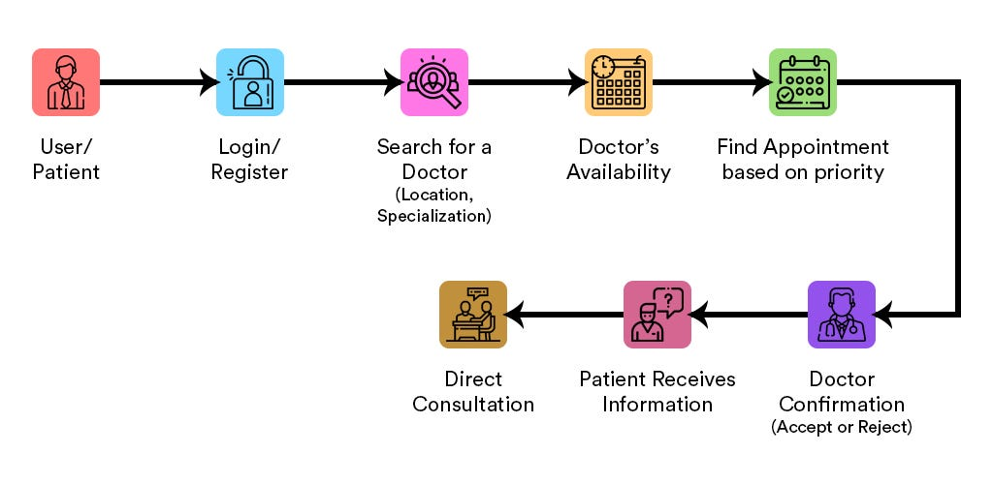
Representation of healthcare appointment system

Slide 13
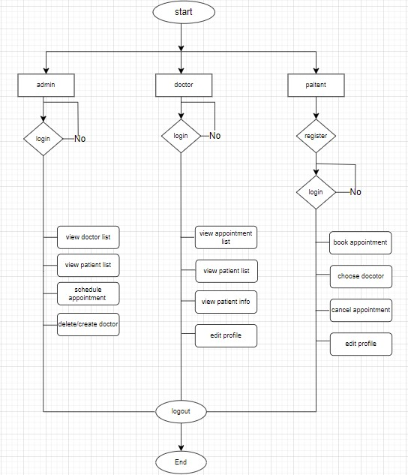
6. System Design Flowchart Of Healthcare Appointment System

Slide 14
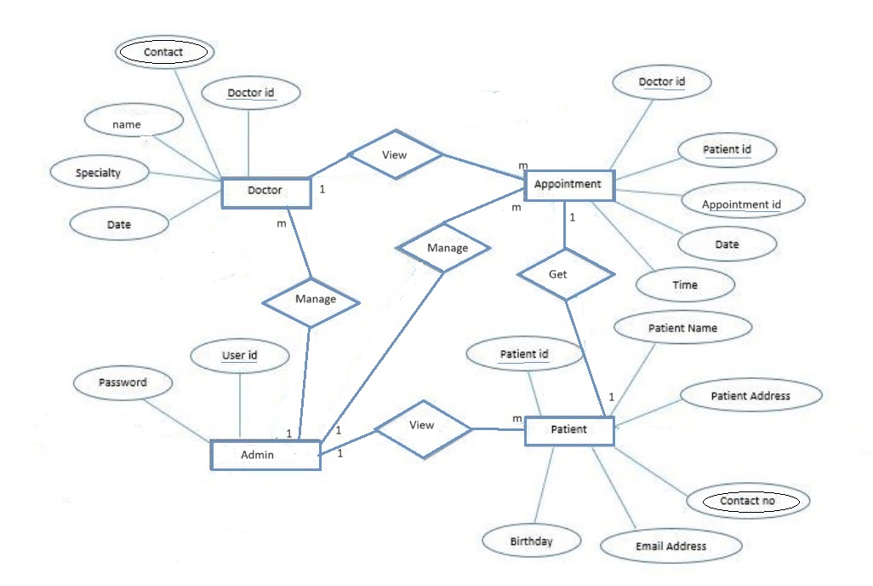
Entity relationship diagram of Healthcare appointment system

Slide 15
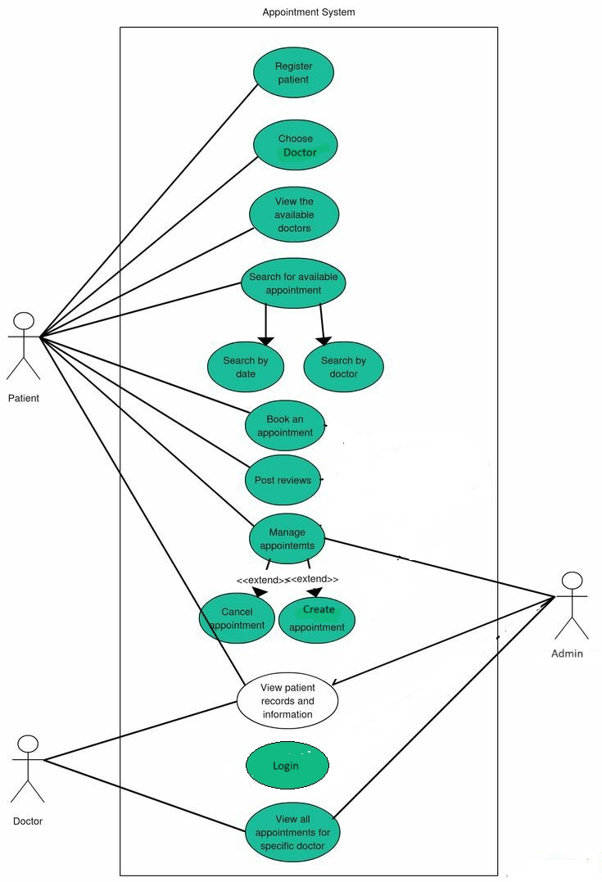
Use case diagram

Slide 16
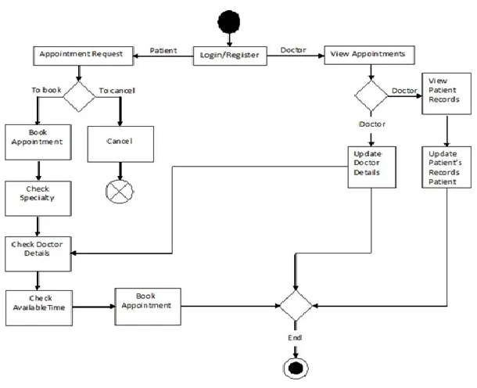
Activity Diagram

Slide 17
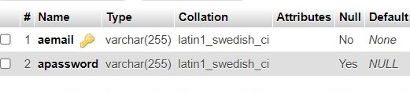
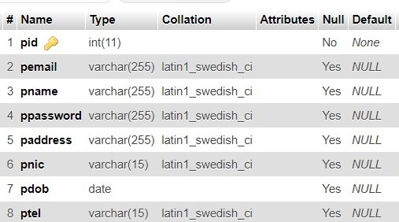
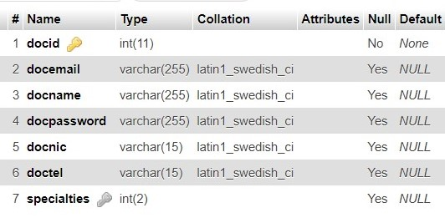
Database Design
Admin:
Patient:
Doctor:

Slide 18
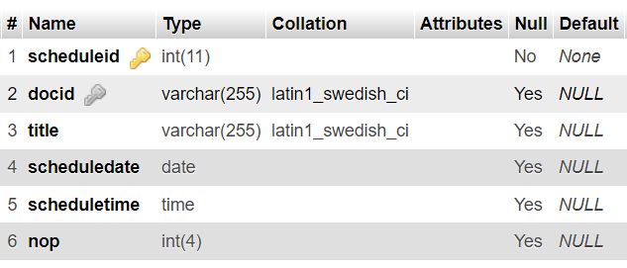
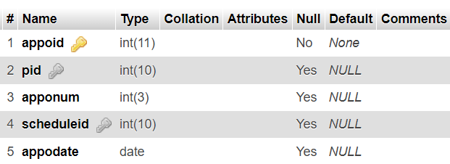
Schedule:
Appointment:

Slide 19
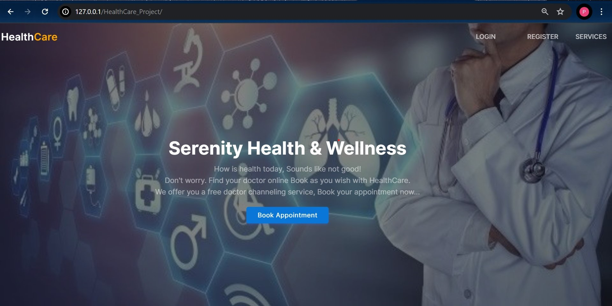
Home page

Slide 20
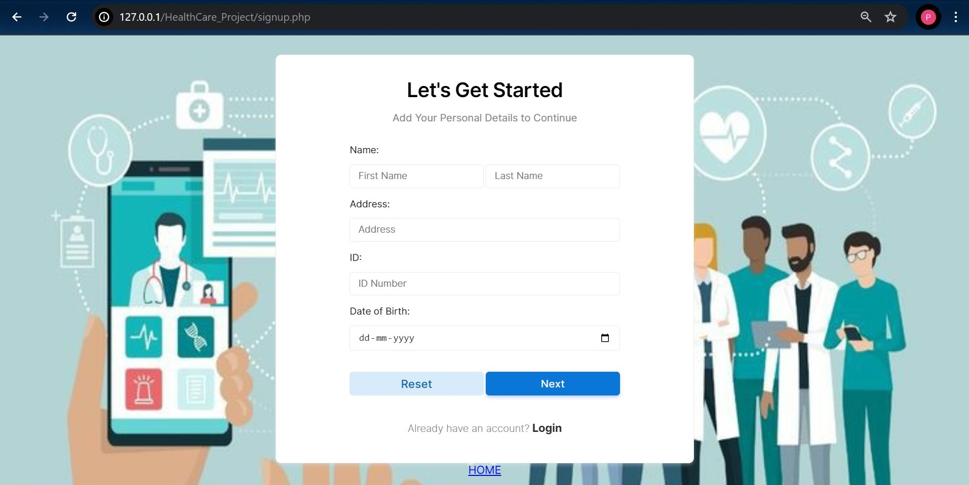
Register page

Slide 21
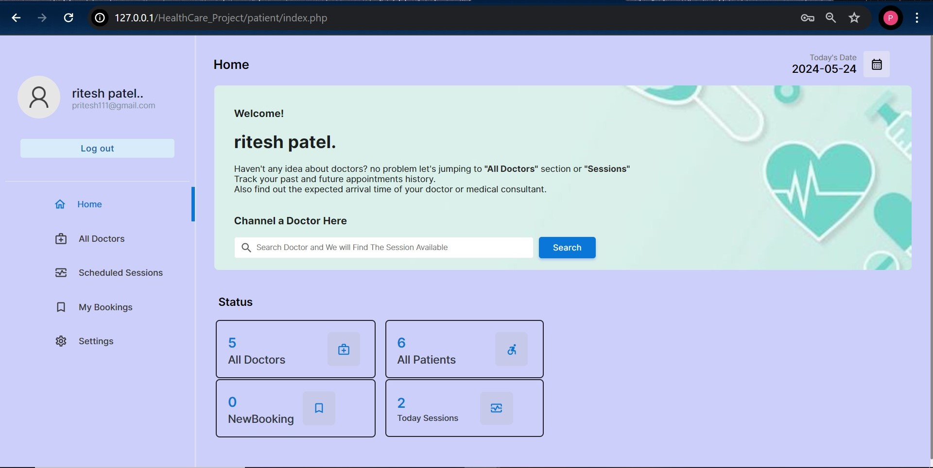
Patient Dashboard

Slide 22
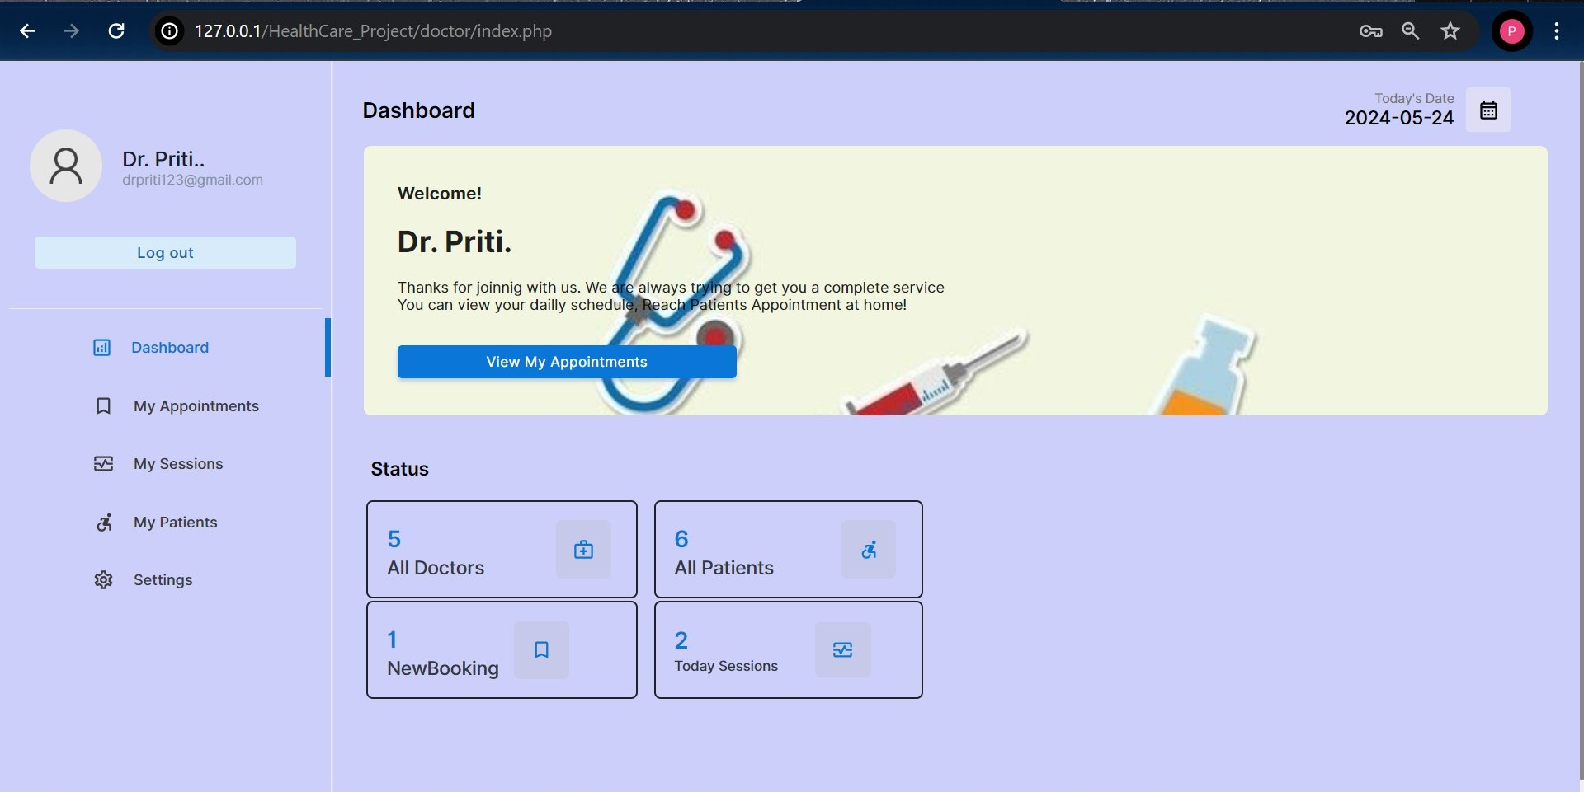
Doctor dashboard

Slide 23
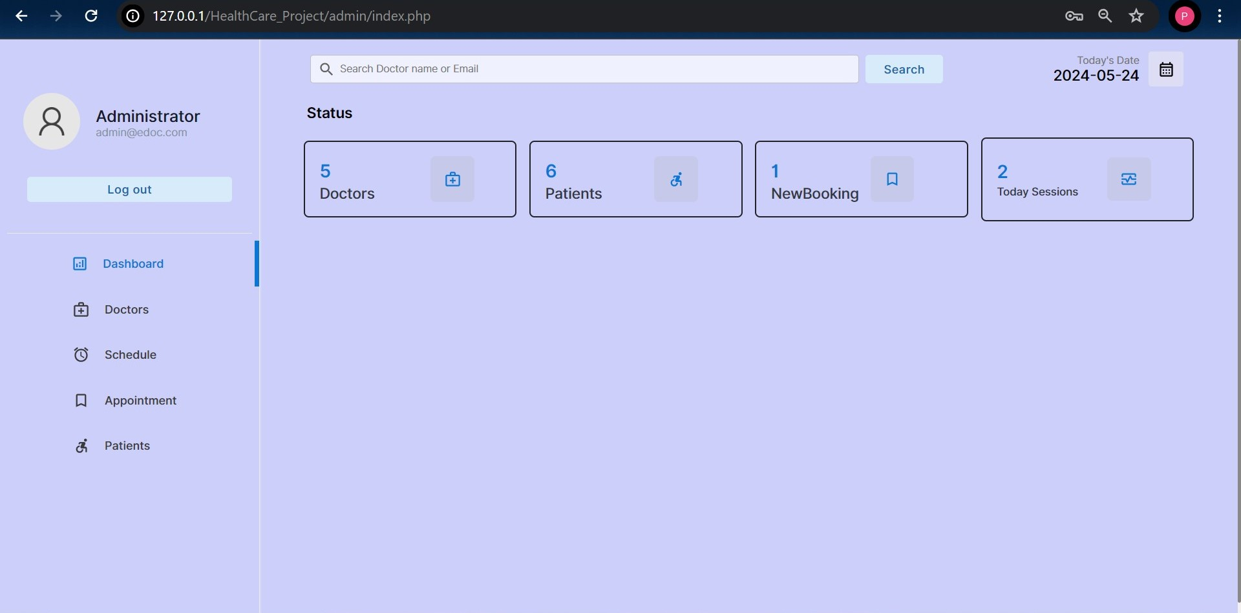
Admin Dashboard

Slide 24
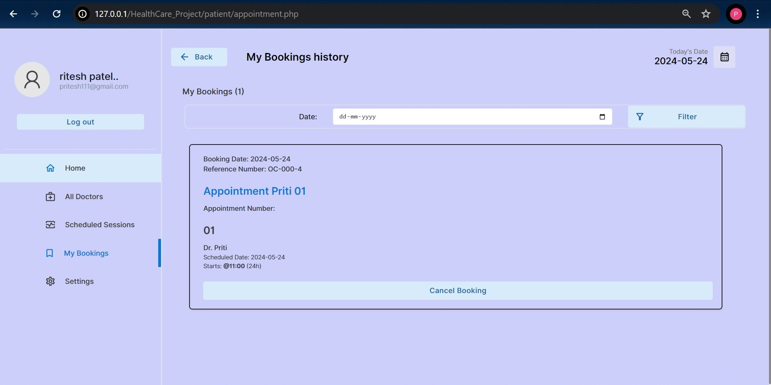
Booking appointment

Slide 25
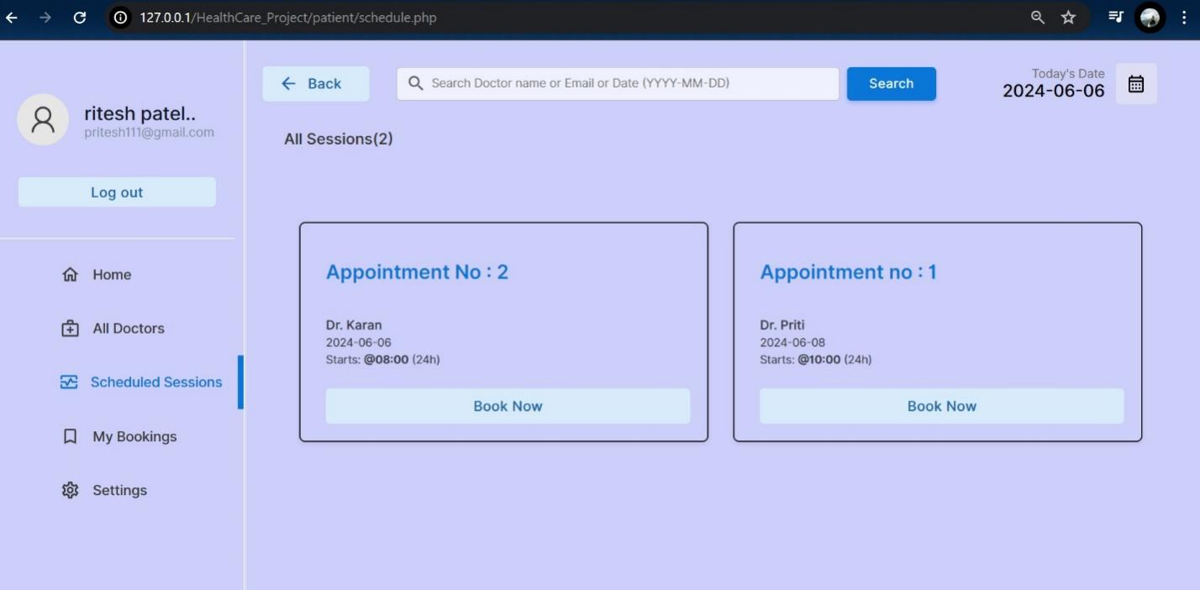
Schedule session

Slide 26
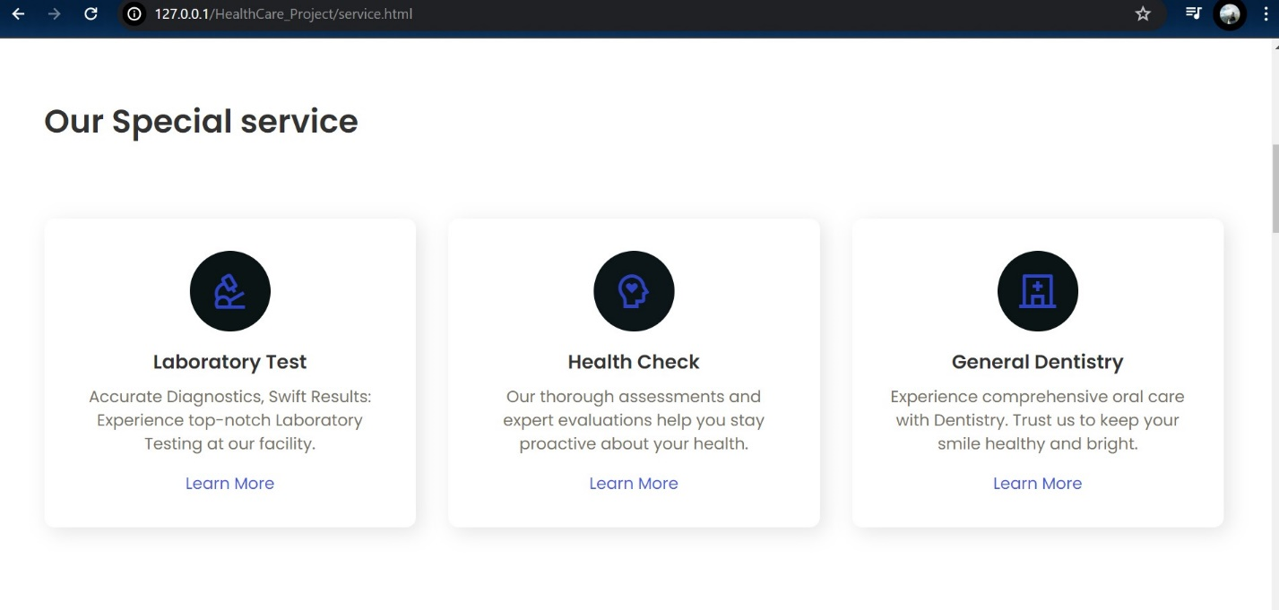
Service page

Slide 27
Future Scope
Advance Report :
Think About Adding More Detailed Reports To Help Healthcare Administrator Make Smarter Decision. This report could show thinks like trends in appointments and how healthcare providers are doing.
Telemedicine :
Consider adding the ability for patient to have video appointments with healthcare providers. This can make healthcare more connivant specially for people who can’t visit in person.
Better Mobile App :
Keep working on the mobile app to make it easier for people to book an manage appointments from their phone.
Smart scheduling :
Explore using smart computer programs to help schedule appointments And make scheduling flexible .

Slide 28
conclusion
The Conclusion Of Our Project Is Valuable. In Future If We Get Chance We Will Develop This Website For Large Volume.” HealthCare Appointment Scheduling System”
Manual System Has Many Limitations For Doctors And As Well As For Patients Like Doctors Cant Promote Their Clinic In More Efficient Manner And Patient Find It Hard To Locate Certain Specialty Doctor In Less Time But In Online System Doctors Can Promote Their Clinics To Larger Patients Base And Patients Can Find Doctors As Per Their Certain Requirements In Less Time .
Doctors Using These Online System Can Check Their Reviews , And They Can Predict That Their Work Is Going In Right Direction Or Not.
Patients Can Find Any Specialty Doctor As Per Their Illness Require By Just Searching In online System Which Also Provide Them Doctor Near Their Localities.

Slide 29
Thank You

